Slide 1
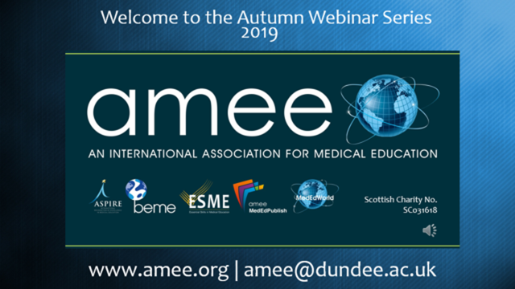

Slide 2

FuturistForum
Conference Highlights

Slide 3
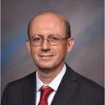
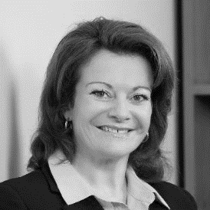
Faculty & Disclosures
Alvaro Margolis
President Global Alliance for Medical Education (GAME)
President & CEO Evimed
Suzanne Murray
Board of Directors GAME
CEO & Founder AXDEV Group
Thomas Kellner
Board of Directors GAME
Board of Directors JECME
Head of Medical Learning UCB
Vice-chair EFPIA Medical Education Working Group
Member of IFPMA EBIC working group
Co-founder iPACME (GAME SIG)

Slide 4
Could you briefly introduce yourself?
Please use that chat to share…

Slide 5
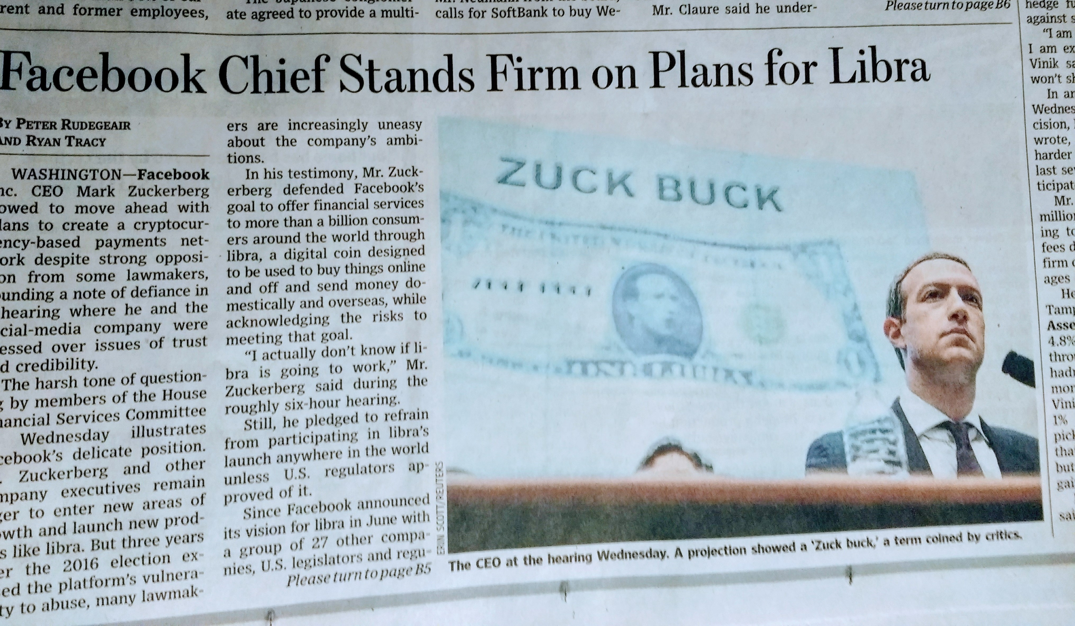
The WORLD IS CHANGING FAST

Slide 6
Vision of GAME
GAME is the global leader in facilitating best practices and collaboration in lifelong learning translation into improved healthcare

Slide 7
CPD GLOBAL COMMUNITY
Institutional CPD professionals and interdisciplinary teams globally
GAME current and past members

Slide 8
What does the future of learning in healthcare mean to you?
Please share your thoughts in the chat…

Slide 9

Why the Futurist Forum?
Global population is increasing by 1 billion
Those over 50 years of age will increase by 500 million
Non communicable diseases are on the rise
Per capita healthcare costs are significantly rising, whilst budgets stay flat and resources are tight
New technology and big data start disrupting healthcare delivery
All the above contributes to accelerating the level of innovation and change in healthcare
To assist medical learning professionals to rapidly prepare for and respond to upcoming challenges and changes

Slide 10
Objectives
On a 10 – 15 years perspective participants…
Identify and describe on a 10-15 years perspective, how the future of learning translation in healthcare will look like
Memorize challenges in the context of healthcare learning that could be resolved with the means of learning technology
Identify stakeholders that may need to collaborate and what their role may be

Slide 11
Desired Outcomes from the FF
Identify the areas that require an evolution considering these 3 themes:
Direction of learning translation science and education (15 year horizon)
Evolution of learning: Big data, technology and AI, as well as learning sciences
Collaborative models:
Why?, Who? and How?
To output a white paper that will capture the process used for the FF and the key areas explored, to prepare our field of professionals in medical learning for the future.

Slide 12
Organizing Committee
Suzanne Murray, co-chair, AXDEV
Thomas Kellner, co-chair, UCB
Dale Kummerle, Merck and Past President, GAME
Alvaro Margolis, Evimed and President, GAME
Celine Carrera, European Society of Cardiology
Celeste Kolanko, Liberium
Amy Berthaut, European Respiratory Society
Samar Aboulsoud, Cairo University
Sherlyn Arnold-Celone, ILP
Dean Beals, DKBmed
Beth Richter, Eli-Lilly

Slide 13
Faculty
Chairs: Suzanne Murray, Thomas Kellner
Mr. Werner Bill, CEO ERS, Switzerland
Professor Eric Bonnefoy, ESC Education Committee, University de Lyon, France
Ms. Anne Depaigne-Loth, Agence National de DPC, France
Professor Aviad Haramati, Georgetown University, US
Professor Jur Koksma, Radboud University, The Netherlands
Dr. Dale Kummerle, GAME past president, MSD, US
Ms. Michèle Lenoir-Salfati. CPD office France, Agence National de DPC France
Dr Susanna Price, president elect ESC, UK
Professor Olaf Wolkenhauer, Rostock University, Germany
Professor Nabil Zary, Mohammed Bin Rashid University of Medicine and Health Sciences, UAE

Slide 14
Process & Faculty Selection Criteria
The process selected is as follows
Three (3) themes were explored
Participants:
  Invited Futurists & Leaders, representing stakeholder groups and various geographies, from academia, medical societies, government & industry (Day1 – on invitation only) and GAME members (Day2)

Slide 15
Agenda
Expert dialogue (on invitation only)
Three (3) keynote speakers to inspire future thinking
Summary of outputs from expert dialogue
Afternoon workshop
  Present the 3 Themes (A,B,C), provide time to reflect, discussion in small groups

Slide 16
Expert Dialogue - The Process
Facilitated Exploratory Dialogue (Chattham House rules apply)
  Three (3) open ended questions (1 per Theme)
    Individual reflection
    Table Reflection
    Sorting and grouping of table reflections
    Prioritization
    Group reflection
    Group prioritization (Day1 only)

Slide 17
Data Capturing & Analysis
The process selected is as follows (Chatham house rules apply):
Notes takers for qualitative data (Day 1 & 2) at each table
Audio and video recording – to be exclusively used for data capturing and analysis (except keynote presentations)
Findings will be anonymized and only presented in an aggregate form
Findings will NOT be shared or used for any other purpose that to compile, analyze and produce a white paper and further dissemination of achieved results
White paper to be submitted to a credible journal

Slide 18
Inspiration from Day 1 Futurist and Stakeholder Leaders
- Highlights Only
Suzanne Murray & Thomas Kellner

Slide 19
Key Outputs from Dialogue
With Futurist Leaders
HIGHLIGHTS ONLY!

Slide 20



Future Healthcare System
Patients
At the core of everything
Active involvement and shared decision making
Preventative Care
Will bind most of the healthcare resource
New roles will be emerging
Illness Care
Will bind only a small portion of resources
Acute hospital care, requiring specialists

Slide 21
Future of Healthcare Learning
Competencies: Increased focus on behavioural science – „Relational theory?“
Empathy, humanised behaviour, shift towards emotional intelligence, resilliance, communication
Continous lifelong learning
Adaptive learning,
Outcomes- and competence-based learning
Patients at the heart of decision-making
Empowered to become more in charge of their own healthcare
Interpreting their own data, Identifying their own needs, educationally and health-wise - Health literacy
Continued learning as its own goal
Continuous self-assessment
Joining the interprofessional team

Slide 22
Curricula & Technology
Moving towards Learning ERA: Educational programme, interventions, curriculum
Development of curriculum for educators in education
Technology and its role in patient health & clinical decision-making
All boils down to outcome-based education – should be the new standard of assessment
New roles need to be recognised
Pre- and post-graduate learning will merge
Collection of health data on patient level
Need for education on digital literacy
Optimising communication, modes of education
Point of care, on-the-job training
Digital colleagues
Deep learning, use of AI and algorithms
Overcome barrier of institutionalised learning (decentralising)
Moving away from a teacher-centric to learner-centric model
Learning as a continuum

Slide 23
Barriers that can be resolved through technology
Interprofessional collaboration (inc social workers)
Integration of care across healthcare workforce (redefining HCP)
Resistance to new roles & technologies
Misalignment of incentives
Data administration
Data vs information
Processing large amounts of clinical information
Quality/comparative and access of data
Burden of administration and reporting
Reimbursement
Academic recognition
Self-care and access to care
Technology is a challenge in itself
Electronic medical records – availability, use
Use; benefits vs the risks of technology
Ownership of preventative healthcare
Public sector has no strategy
Motivation related to preventative healthcare
Translation of knowledge into practice
Knowledge transfer will be assisted by technology

Slide 24
Technology solutions
Virtual Communities of Practice (VCoP)
Moving education and healthcare to virtual space (e.g. telemed)
Personalised virtual care
Patient access to their own data
Education around digital literacy and what their data means
Initiate a public debate around technology and its use in health with multiple stakeholders
Addressing language and culture barriers
Issues of translation will be resolved by 2035
Implementation of communities and practice
Need for more expirmentation on benefits and risks

Slide 25
Collaboration: Why? Who? How?
There were multiple collaborative models discussed across the group
There was consensus on „who“ should collaborate
Healthcare professionals
Patients
IT
Unknown Guest
More reflection needed on potential collaborators, dependent on models
One collaborative model will not fit all needs
Definition of collaboration is needed
Government
Industry

Slide 26

You have completed your journey!...

Slide 27

Your Comments...
Your Feedback...
Your Experience...

Slide 28














